Slide 1
Nucleotide Sequencing in Outbreak Detection and Response
Gregory L. Armstrong, MD
Director, AMD Program
US Centers for Disease Control and Prevention

Slide 2
Sequencing in Public Health

Slide 3
Trends in Sequencing Output
Sanger Sequencing
Next-Generation Sequencing
Moore’s Law
Adapted from NHGRI (https://www.genome.gov/sequencingcosts/)

Slide 4
NGS at CDC—Selected Applications
Diagnostics
MicrobeNet—ID of unusual bacterial pathogens
Unexplained respiratory disease outbreaks
HCV infection classification
Digital PCR for hepatitis viral load
Parasitic diseases
WGS for bacterial pathogen typing and inference of phenotype
Bacterial foodborne disease
Mycobacterium tuberculosis
Pneumococcus, GAS, GBS
Meningococcus, H. influenza
Legionella
B. anthracis: forensics
B. pertussis: subtyping and investigation of emergence
HAI/antimicrobial resistant bacterial
Genomic typing of eukaryotic pathogens
Cyclospora
Cryptosporidium
Leishmania
Coccidioides
Diagnosis and typing of viral pathogens
Influenza
Viral vaccine-preventable diseases
HIV
HCV (“GHOST” system)
Dengue, chikungunya, Zika
Norovirus
Malaria
Anti-malarial resistance in plasmodia
Insecticide resistance in vectors
Multiplicity of infection to assess transmission intensity
Pathogen discovery
Application of NGS
Arboviruses

Slide 5
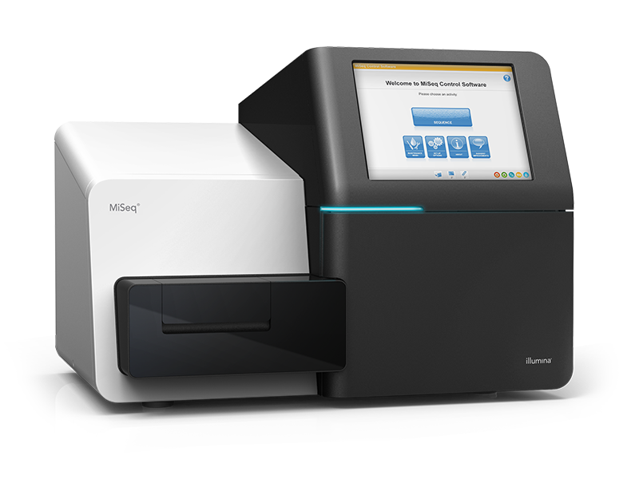

Sequencing Technologies
Illumina MiSeq
Short-read sequencing (~200-250nt)
High throughput
High accuracy
Run time: ~24-48 hrs
Oxford Nanopore MinION
Long-read sequencing (mean, ~10,000 nt)
Lower accuracy
Run time: typically < several hours

Slide 6
Sequencing in Outbreaks

Slide 7
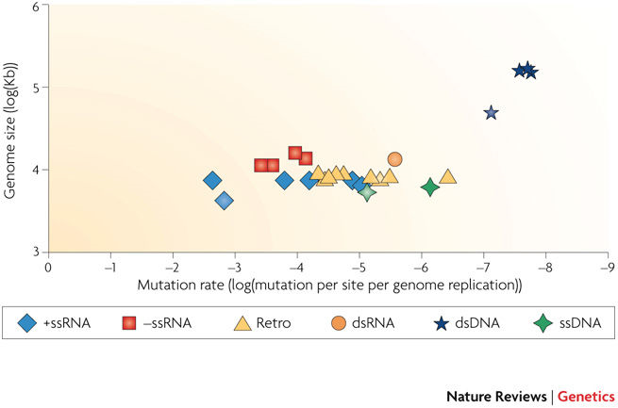
Evolutionary Rates of Pathogens
Viruses
Bacteria
~ 10⁻⁷ to 10⁻⁶ per site
per year
Rate depends on species
and strain
Source: Duffy S et al. Nature Reviews Genetics 2008;9:267–276.

Slide 8
Two Levels of Utility of Genomic Data in Outbreaks
Actionable
Real-time data use
Data used in decision-making
Academic
Data not necessarily used in real-time by response team
BUT,
may be useful in developing diagnostics or therapeutics
may lead to understanding of how outbreak occurred or why the pathogen is emerging
may lead to better ability to respond to outbreaks in the future
may provide other useful information

Slide 9

Source: Gytis Dudas, University of Washington, Seattle

Slide 10
Example1: Bacterial Foodborne Illness

Slide 11

Listeria Outbreak, United States, 2014
Allele differences at node: median [min–max]
(>5,800 loci analyzed by BioNumerics software)
PFGE
89 [89–89]
Hot dog and patient
PFGE Pattern 1
5 [1–114]
PFGE Pattern 2
PFGE Pattern 3
Cluster 1 (≤6 allele differences)
4 [1–6]
1,628 [0–1,694]
Not closely related
(minimum 1,628 allele differences)
Cluster 2 (≤10 allele differences)
3 [0–10]
4 [0–44]
Unrelated patient isolate (Sept. 2014)
Data as of December 9, 2014

Slide 12
U.S. Listeria Outbreaks, Before and After WGS
Source: Jackson BR. Clin Infect Dis 2016;63:380-6; and CDC/OID/NCEZID/DFWED

Slide 13
Example2: Hepatitis C Virus

Slide 14
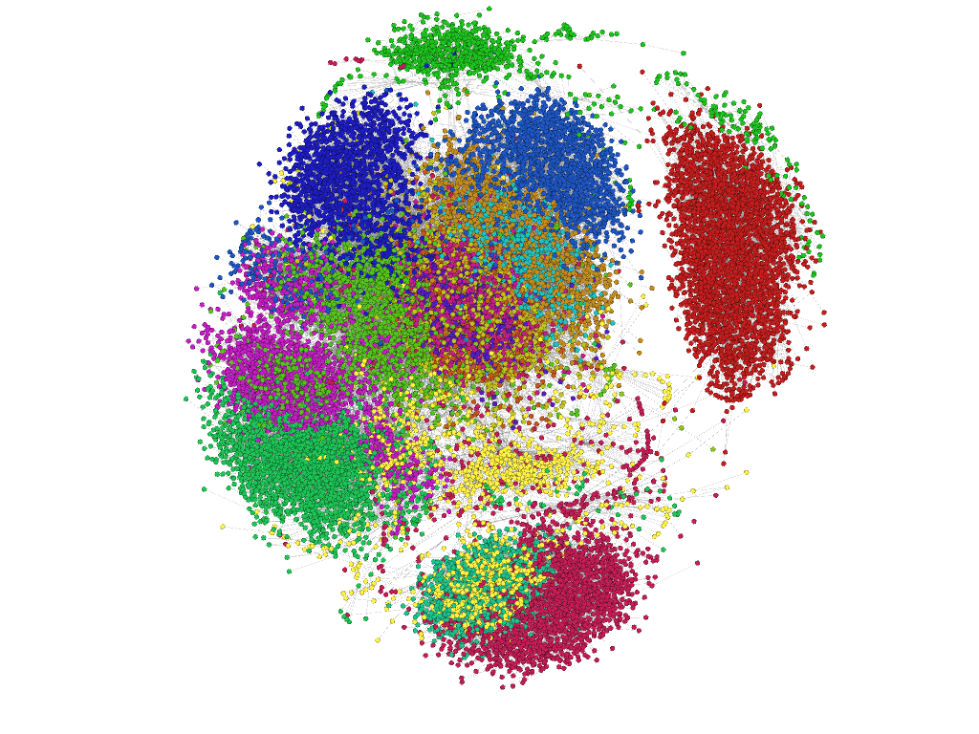
Hepatitis C Outbreak,
Healthcare Facility A
18 cases
~23,000 unique sequences.
~1,000 shared sequences
Each node is a unique sequence
Major connected component shown
Different patients are shown in different colors
Two sequences are linked if they differ at a single nucleotide position

Slide 15
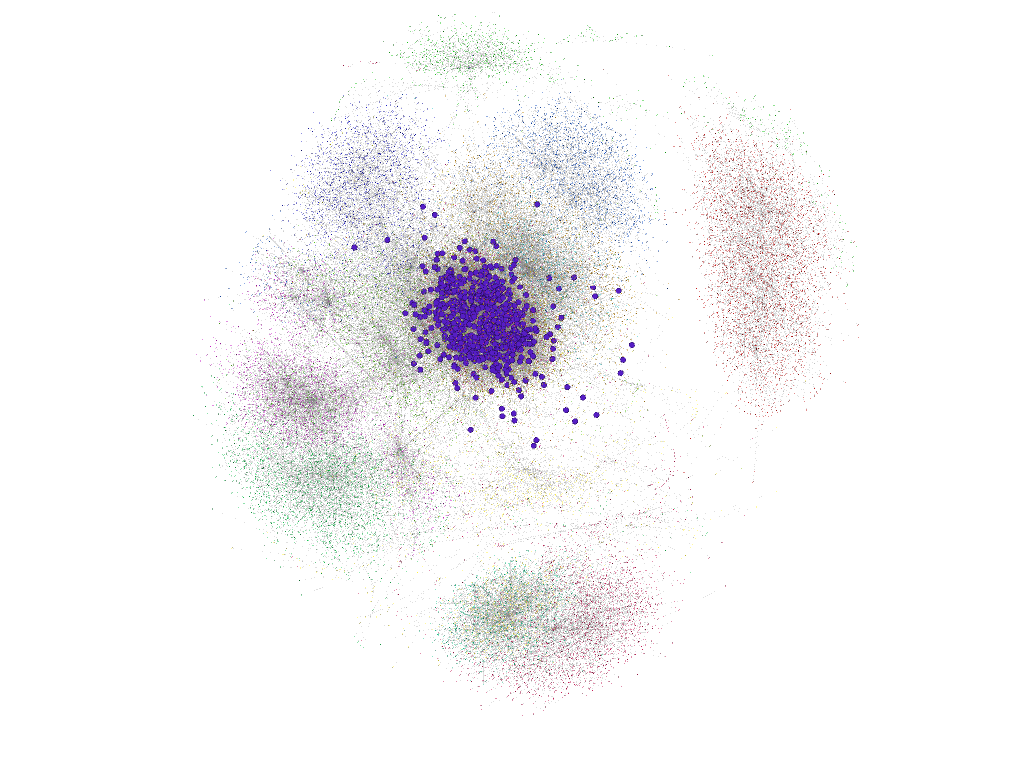
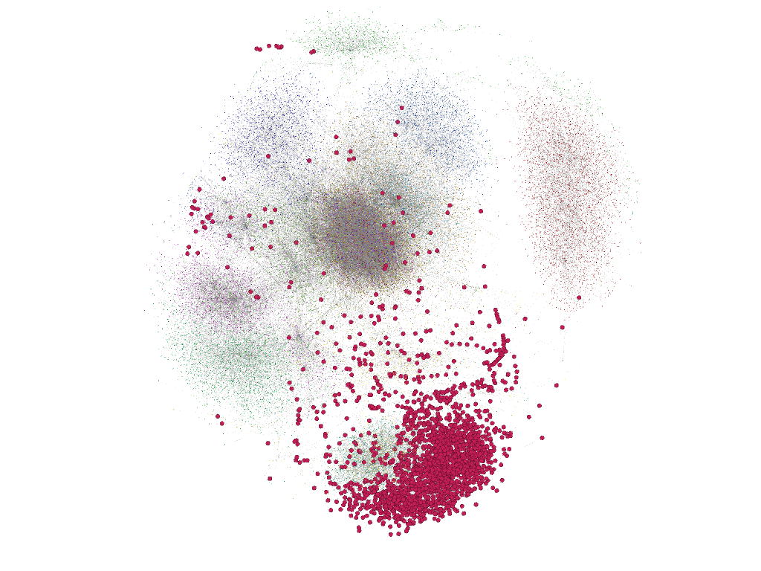
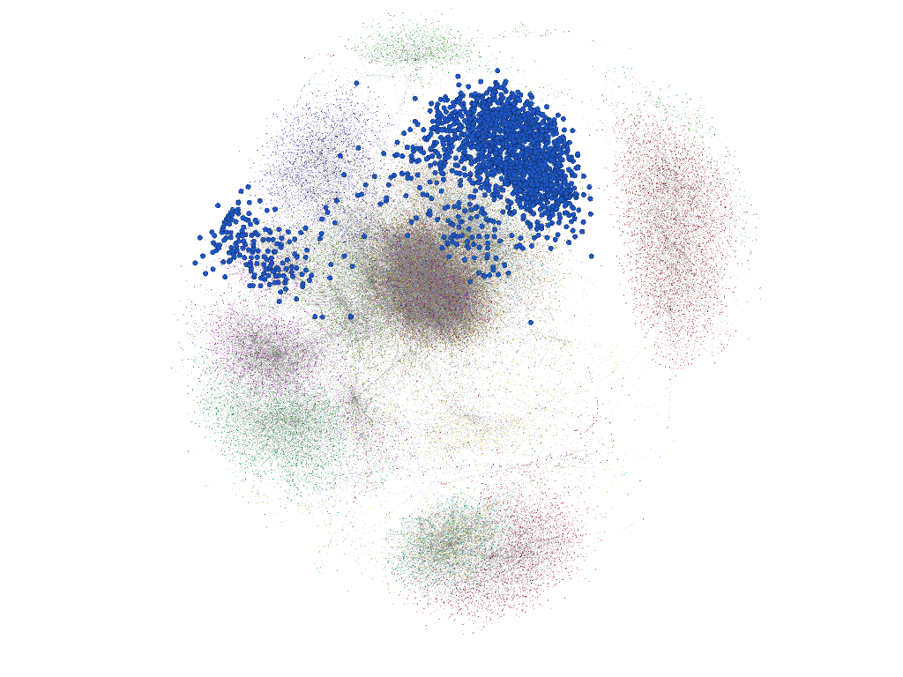
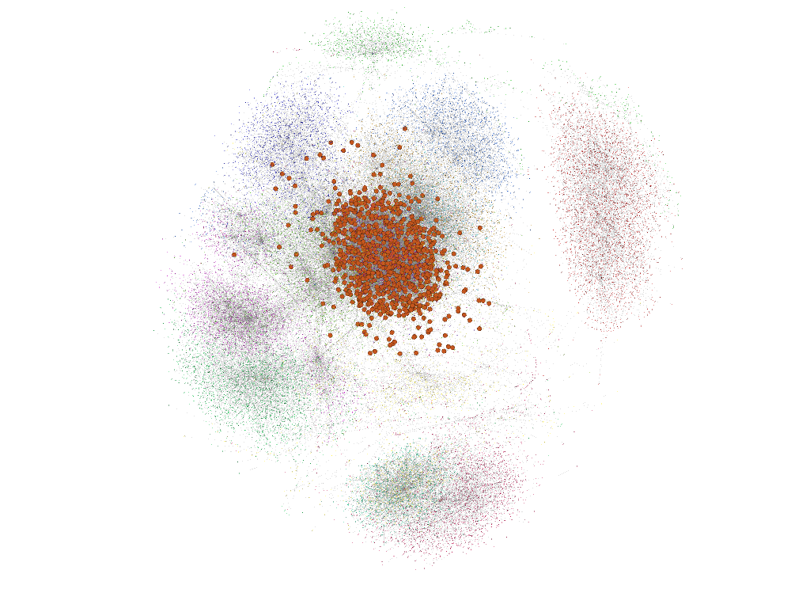
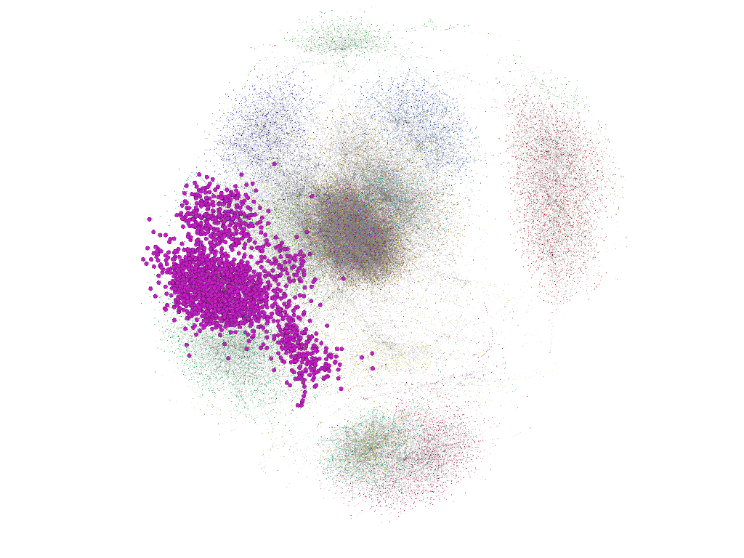
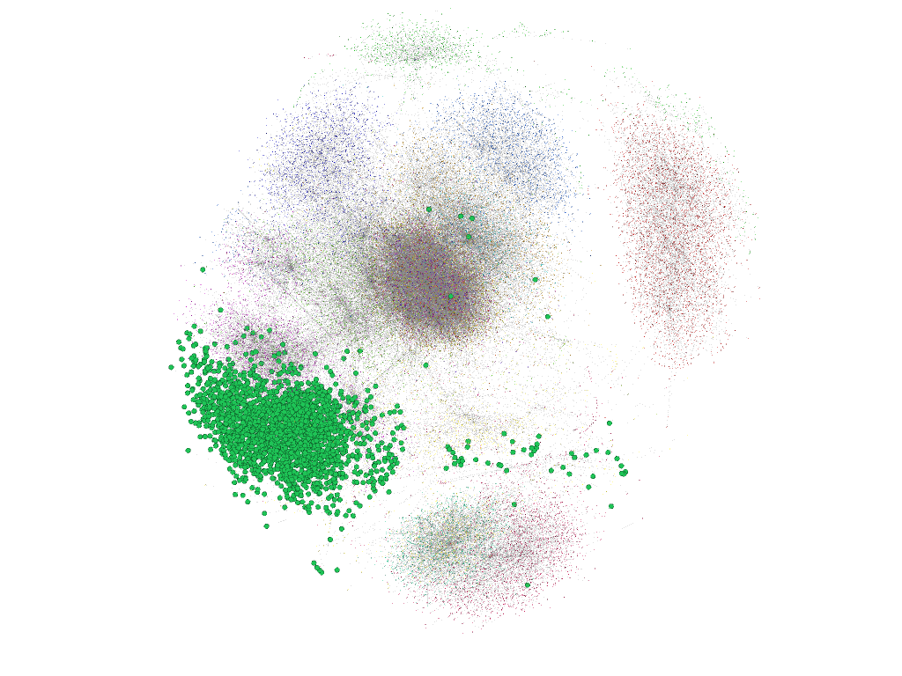
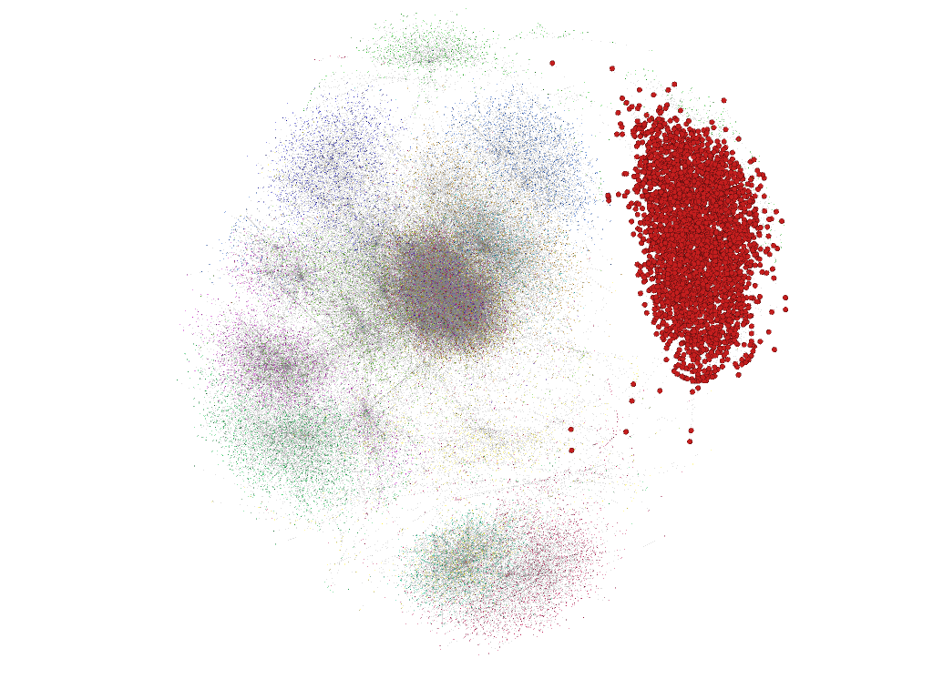
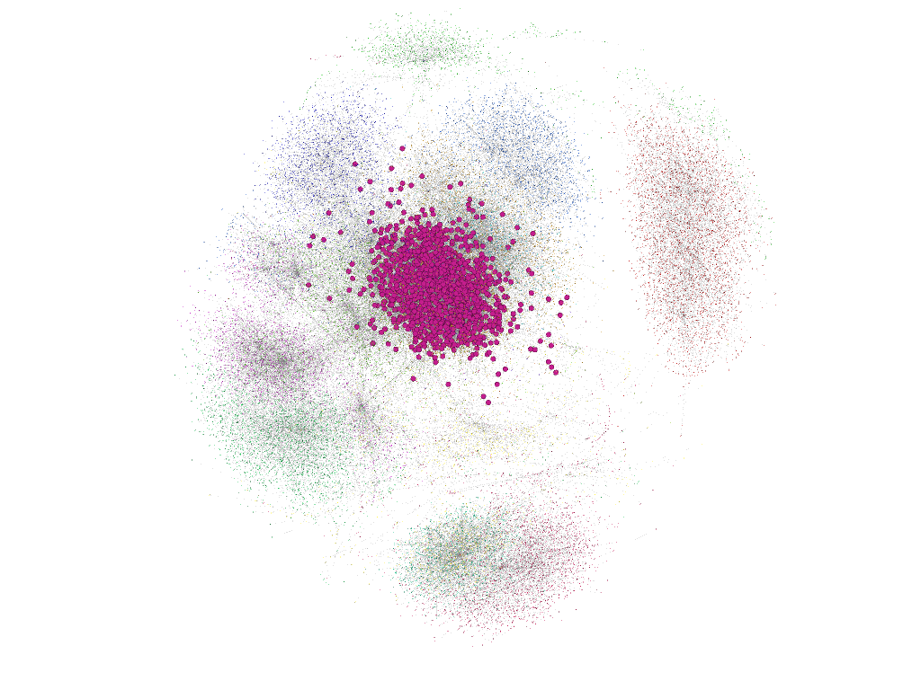
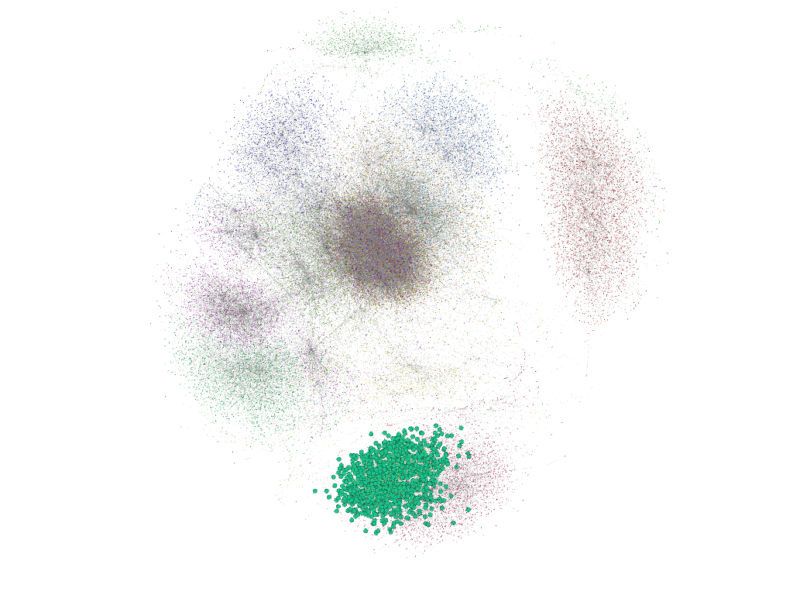
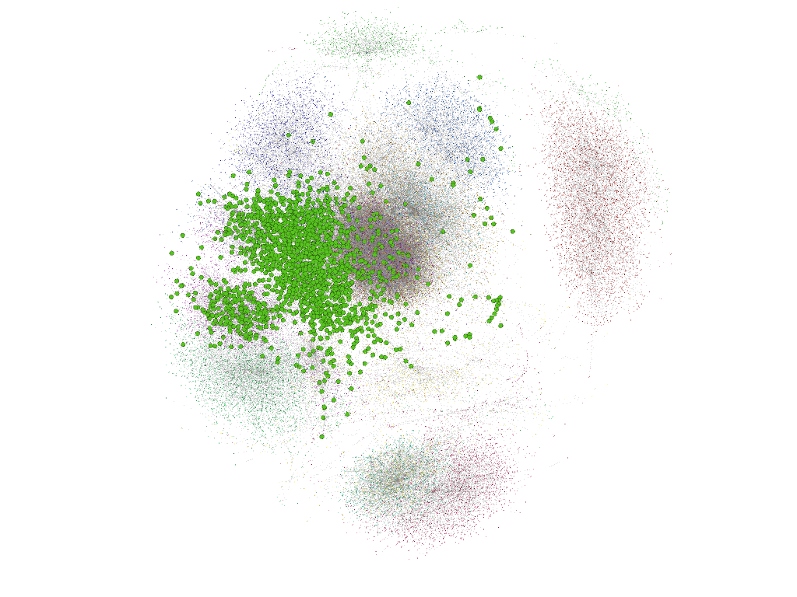
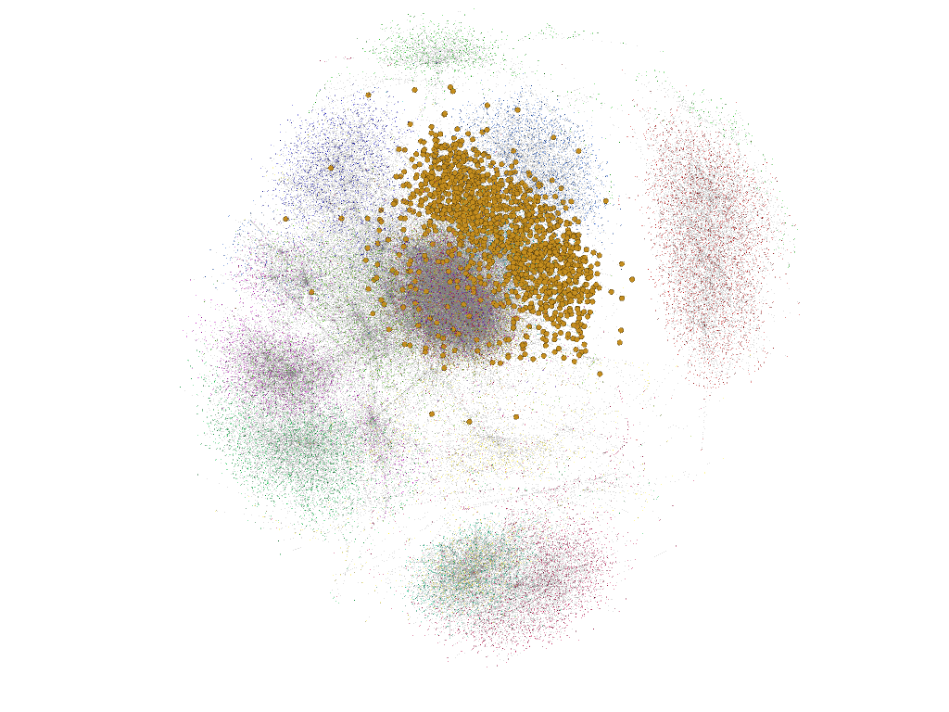
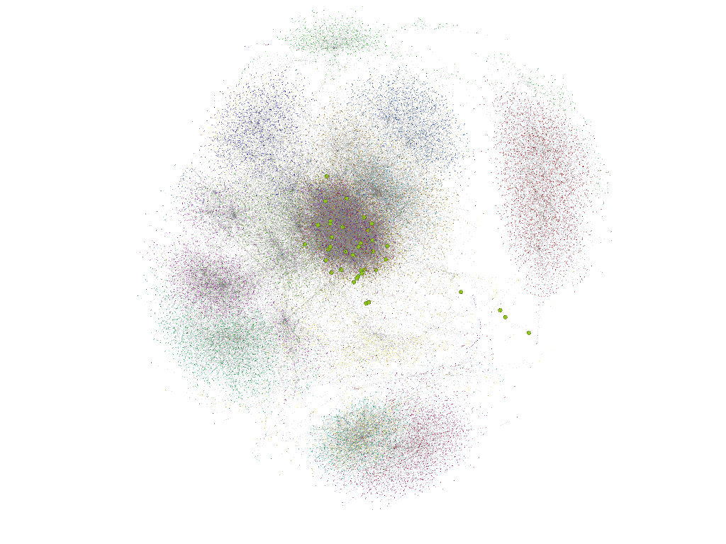
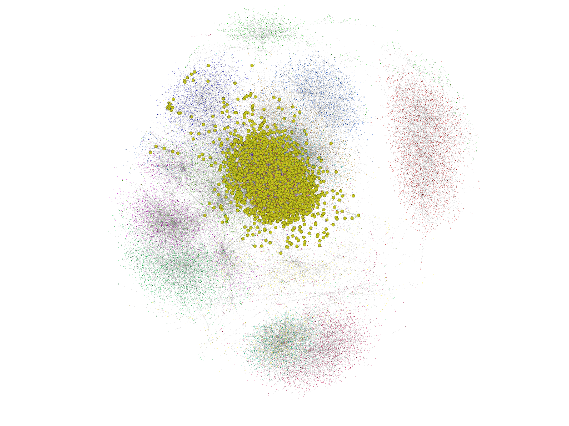
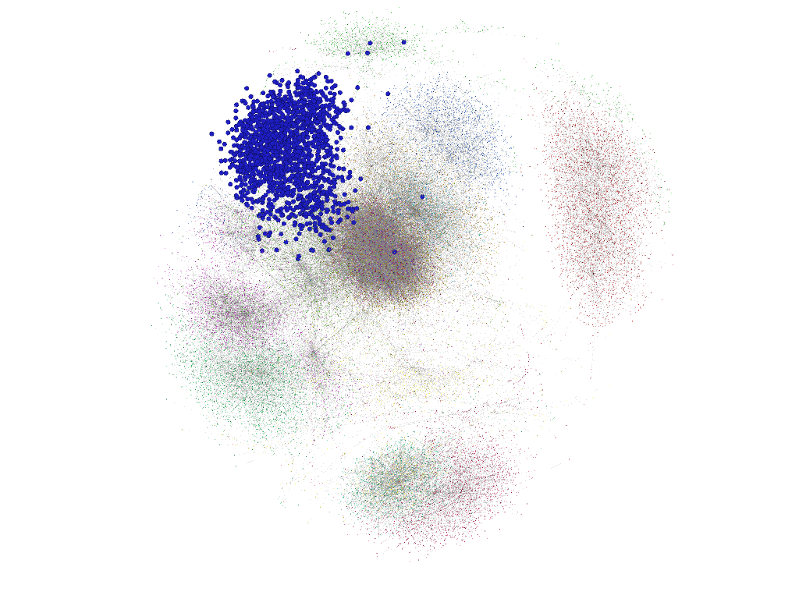
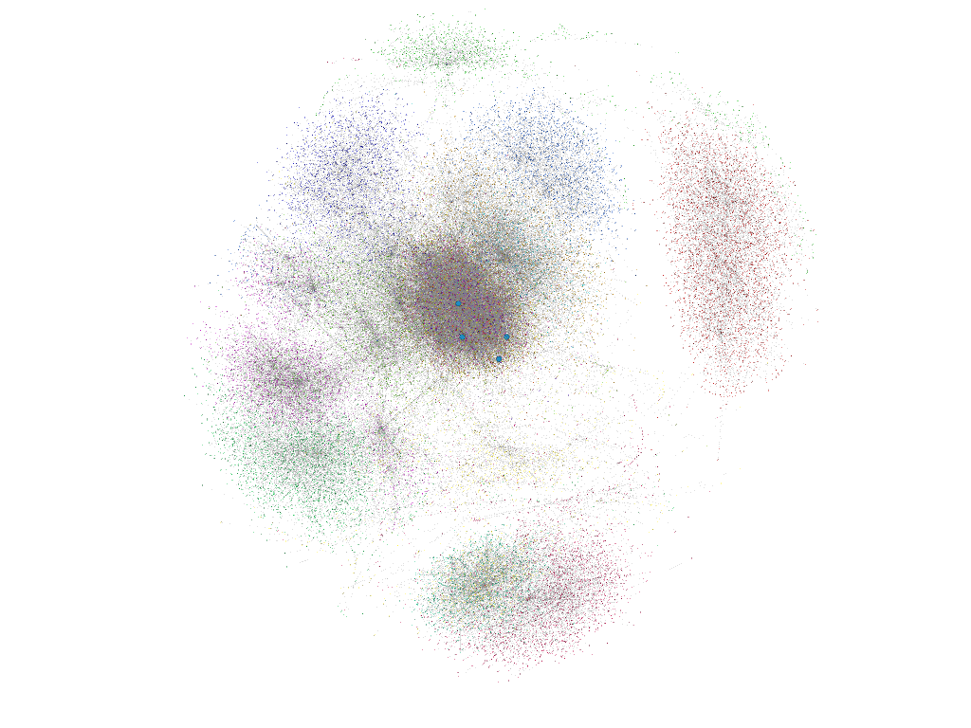
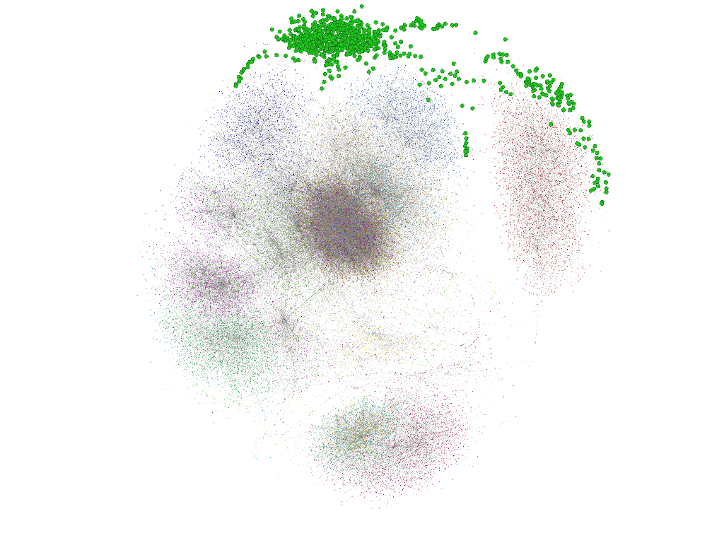
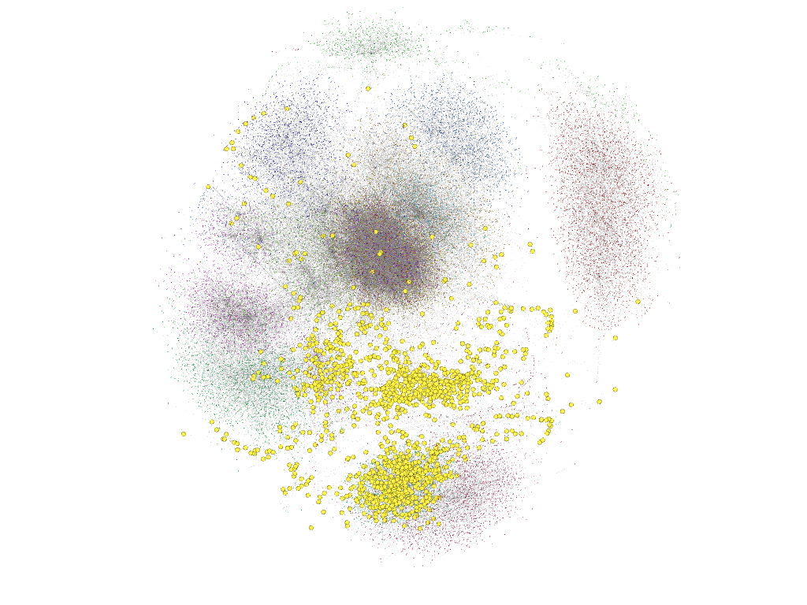
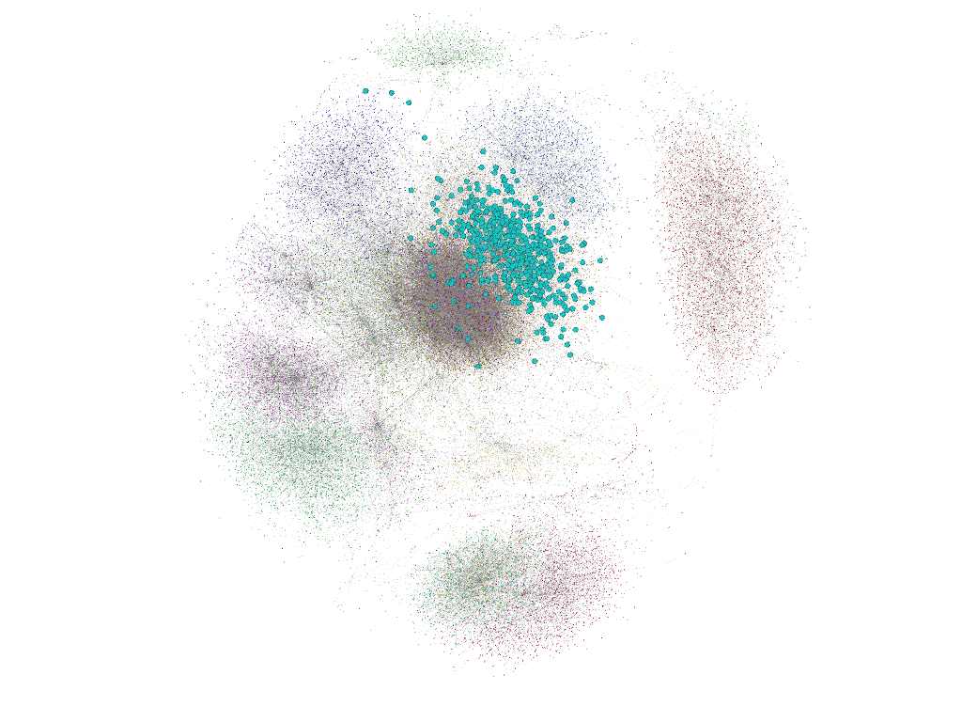

Slide 16
Example 3: Ebolavirus

Slide 17
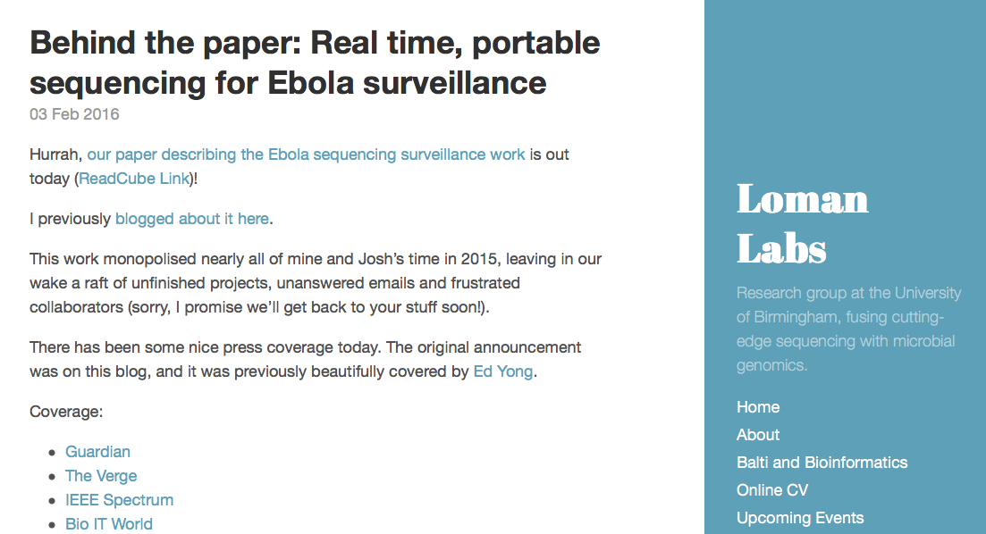
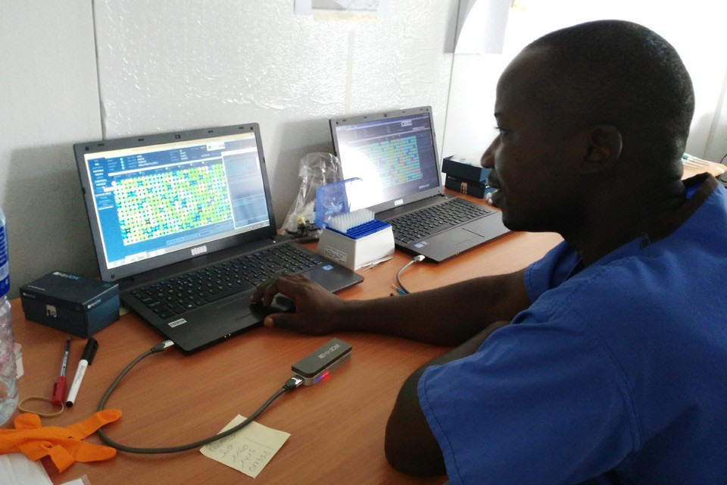
http://lab.loman.net/2016/02/03/behind-the-paper-real-time-portable-sequencing-for-ebola-surveillance/

Slide 18
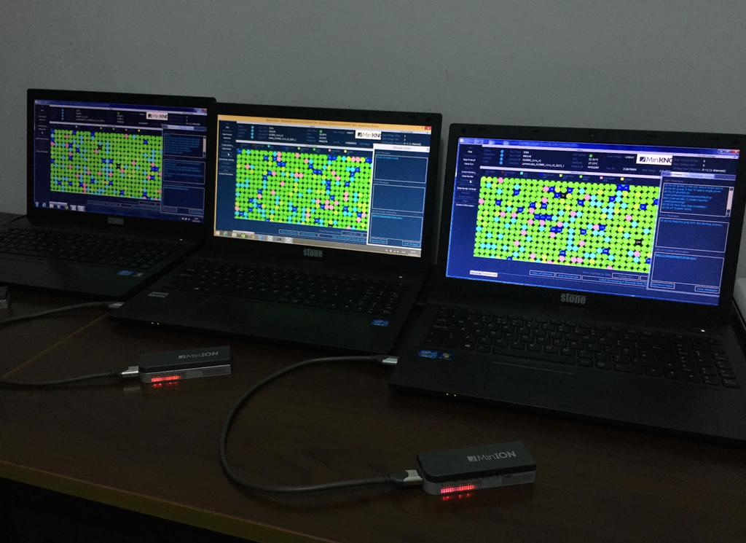
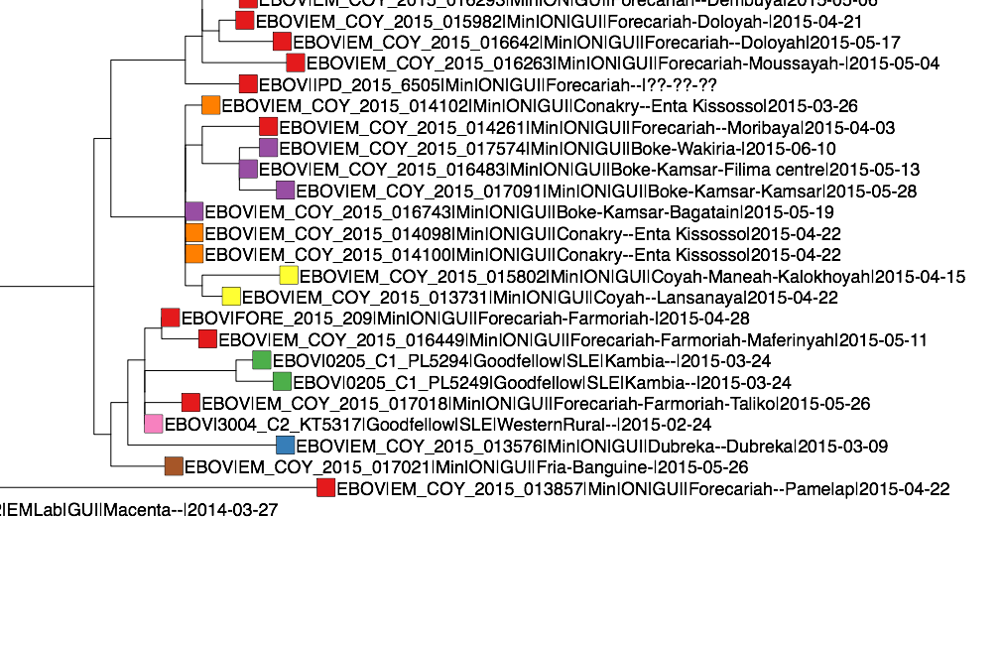
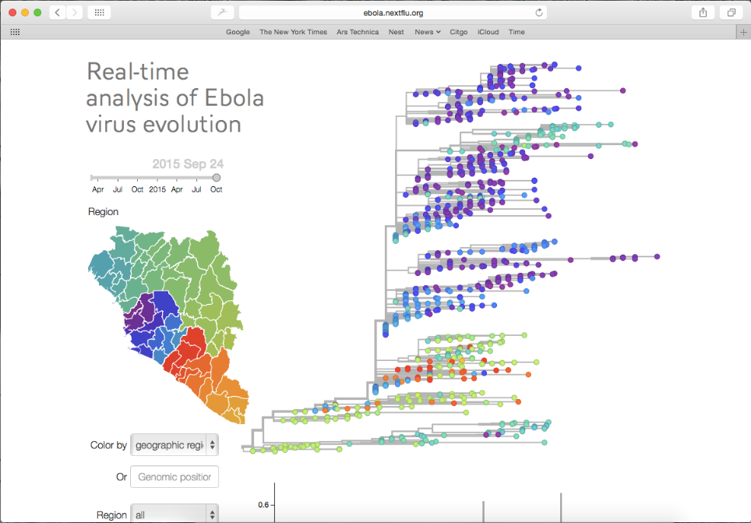
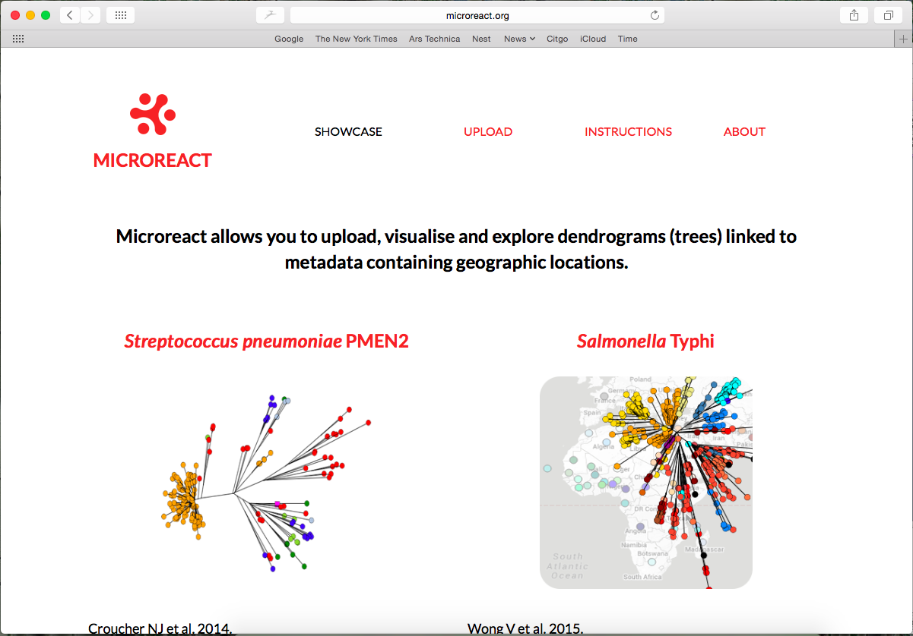
Unexplained Ebola Case, Fria Prefecture, Guinea
European Mobile Lab, Coyah
nextflu.org
microreact.org
Source: Miles Carrol, Public Health England; Nick Loman, University of Birmingham; Stephan Günther & Sophie Duraffour, Bernhard-Nocht Institute for Tropical Medicine. Sequencing: European Union Mobile Laboratory, Coyah, Guinea. Analysis: N Loman. Visualization: MicroReact.org, Aanensen Research Group, Imperial College. Consensus sequence sharing: nextflu.org.
Notes:
Now let’s go forward to 2015 and consider Ebola, a very different disease. With Ebola, transmission pathways are generally very clear—you don’t need sequencing to understand them in the way you do polio. However, there are always outlier cases for which case investigation fails to reveal the source.
[discussion about sequencing in the 2014-2015 W Africa Ebola outbreak]
[discussion about how the group at the bottom of the slide set up a particularly effective way of monitoring the genetic epidemiology and communicating this with response staff]
In this example, an Ebola case had occurred in Fria Prefecture after a few months without a case. After extensive investigation, the source of the case was not found, but there was a suggestion that sexual transmission may have played a role—the head of the household had probably been infected 6 months earlier when he was in Conakry. At the same time, there was concern that the test could been a false positive or a cross-contaminated sample. Sequencing, however, showed that the virus was much more closely related to viruses circulating along the Guinean border with Sierra Leone at the time, and was likely due to a missed chain of transmission. [the viruses circulating in Conakry 6 months earlier—not shown here—were very distant] The fact that the virus was unique suggests it was unlikely to have been a result of cross-contamination in the laboratory.
Note: rate of mutation, ~0.0013 per year, or ~1 nt every 2 weeks.

Slide 19
Unexplained Ebola Case, Fria Prefecture, Guinea
European Mobile Lab, Coyah
nextflu.org
microreact.org
Source: Miles Carrol, Public Health England; Nick Loman, University of Birmingham; Stephan Günther & Sophie Duraffour, Bernhard-Nocht Institute for Tropical Medicine. Sequencing: European Union Mobile Laboratory, Coyah, Guinea. Analysis: N Loman. Visualization: MicroReact.org, Aanensen Research Group, Imperial College. Consensus sequence sharing: nextflu.org.
Notes:
Now let’s go forward to 2015 and consider Ebola, a very different disease. With Ebola, transmission pathways are generally very clear—you don’t need sequencing to understand them in the way you do polio. However, there are always outlier cases for which case investigation fails to reveal the source.
[discussion about sequencing in the 2014-2015 W Africa Ebola outbreak]
[discussion about how the group at the bottom of the slide set up a particularly effective way of monitoring the genetic epidemiology and communicating this with response staff]
In this example, an Ebola case had occurred in Fria Prefecture after a few months without a case. After extensive investigation, the source of the case was not found, but there was a suggestion that sexual transmission may have played a role—the head of the household had probably been infected 6 months earlier when he was in Conakry. At the same time, there was concern that the test could been a false positive or a cross-contaminated sample. Sequencing, however, showed that the virus was much more closely related to viruses circulating along the Guinean border with Sierra Leone at the time, and was likely due to a missed chain of transmission. [the viruses circulating in Conakry 6 months earlier—not shown here—were very distant] The fact that the virus was unique suggests it was unlikely to have been a result of cross-contamination in the laboratory.
Note: rate of mutation, ~0.0013 per year, or ~1 nt every 2 weeks.

Slide 20
Example 4: Poliovirus

Slide 21
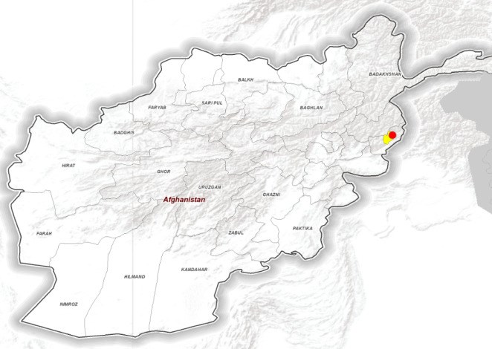
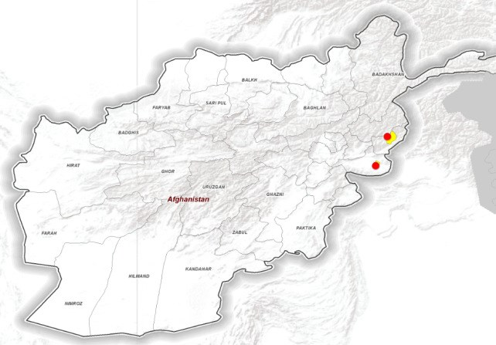
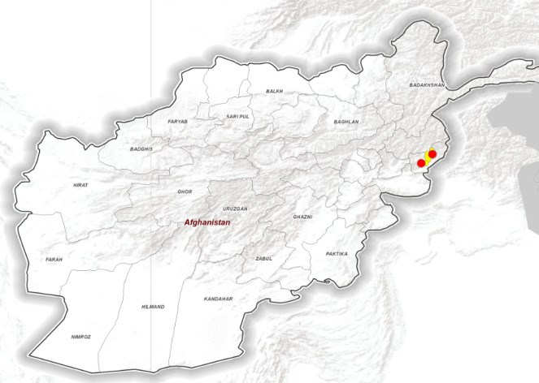
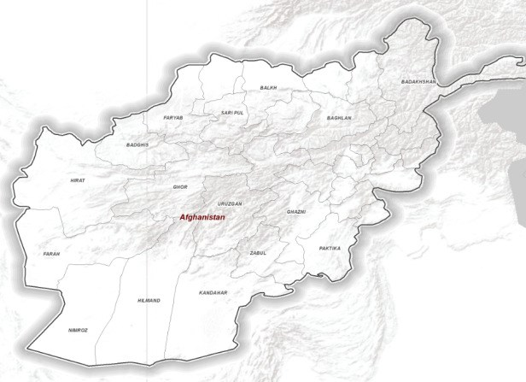
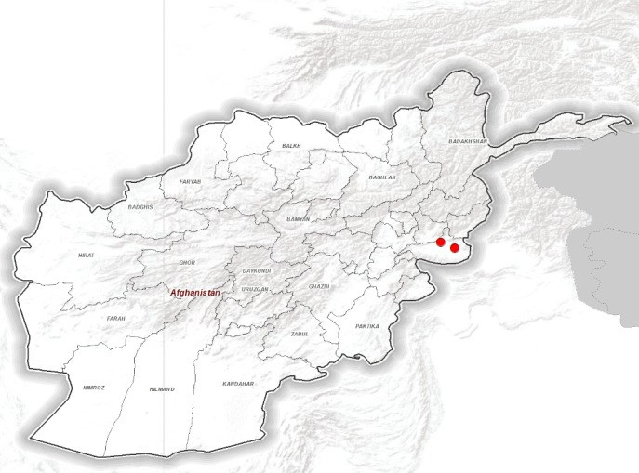
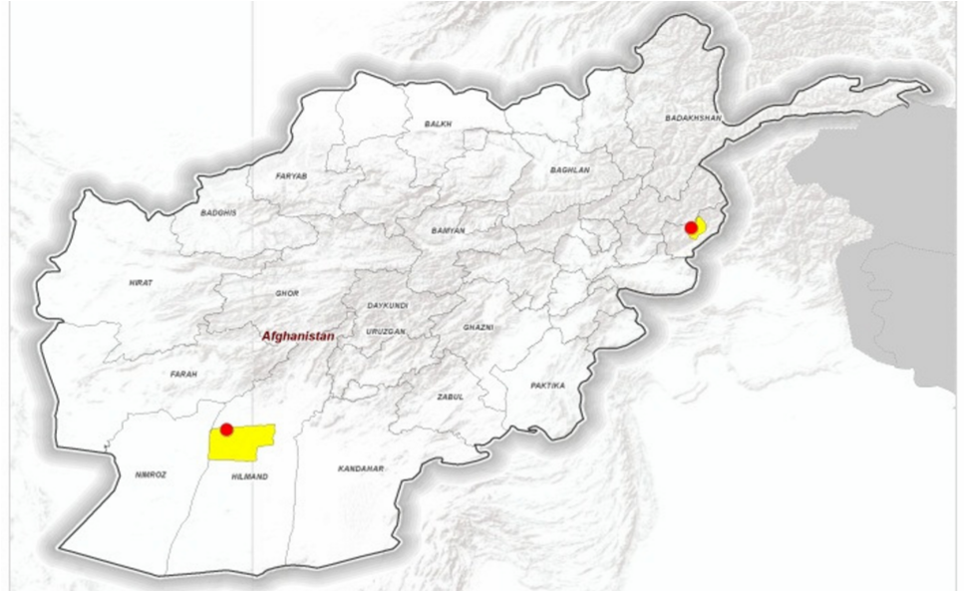
WPV1, Afghanistan, Late 2013
July 2013
Aug 2013
Sep 2013
Oct 2013
Nov-2013
Oct-2013
Nov 2013
Dec 2013
(
W1=2, cVDPV
(
W1=2, cVDPV
2=0)
(
W1=0, cVDPV
2=0)
2=0)
Cases previous 6m = 10
Data in WHO/HQ as of 14 Jan 2013
Latest: 20-Dec-13 (W1)
24
Notes:
Let me start with polio, a program that has used sequencing longer than in any other public health program I’m aware of. Wild poliovirus type 1 causes paralysis in fewer than one in 200 infections. For that reason, even with excellent surveillance, you can’t infer much about transmission pathways based on the case investigation alone. Beginning in the late 1990s, the polio program began sequencing every wild poliovirus in the world, and sequencing very quickly became an indispensable part of that program.
The Global Polio Eradication Initiative is now in its final phase and is down to two countries, Afghanistan in Pakistan. This slide shows the situation in Afghanistan in late 2013. First off, you’ll notice almost all the cases here [CLICK] are in the east of the country along the border with Pakistan. At first glance, this suggests a failure of the program—that polio was endemic in eastern Afghanistan. However, because we had sequence data at the time, we knew that the virus from every one of those cases was more closely related to viruses in Pakistan than they were to each other. Virus, in other words, was being imported from Pakistan—not surprising, given the amount of cross-border traffic there-- and probably circulating a little, but was not resulting in sustained transmission.
[CLICK] Then in December a case popped up in Helmand Province, the last known site of endemic transmission in Afghanistan. So…, did this represent another importation, or did this indicate that virus was still endemic in Southern Afghanistan—that transmission had been occurring undetected for the prior 13 months?

Slide 22
WPV1, South Asia, Early 2014
2012 viruses
2014 viruses
December 2013 Helmand virus
Notes:
In this case, the answer was not what we wanted to see. The 2013 virus was most closely related to viruses that had been circulating nearby in southern Afghanistan in 2012. By early 2014, ongoing circulation was confirmed with similar viruses also seen in the south. In response, the program both intensified surveillance, since the sequencing results suggested we had likely been missing cases, and made substantial changes to the immunization program in the south of Afghanistan.

Slide 23
Challenges in the Field

Slide 24
The Real World
Collaboration
The sequencing lab
Data transfer (typically, 15-30 GB per run)
Data analysis
Integration with epidemiologic data
Merging
Visualizing
Analyzing

Slide 25
My Own Personal View—Skills Needed During Outbreaks
Facility with data
Engagement with the response
Focus on outbreak response
Ability to work within hierarchy
Ability to articulate
Ability to see big picture

Slide 26
www.cdc.gov/amd
twitter: @cdc_amd
The findings and conclusions in this presentation are those of the author and do not necessarily represent the official position of the Centers for Disease Control and Prevention. Use of trade names is for identiﬁcation only and does not imply endorsement by the Centers for Disease Control and Prevention or by the U.S. Department of Health and Human Services.

